Slide 1
실습
고정재

Slide 2
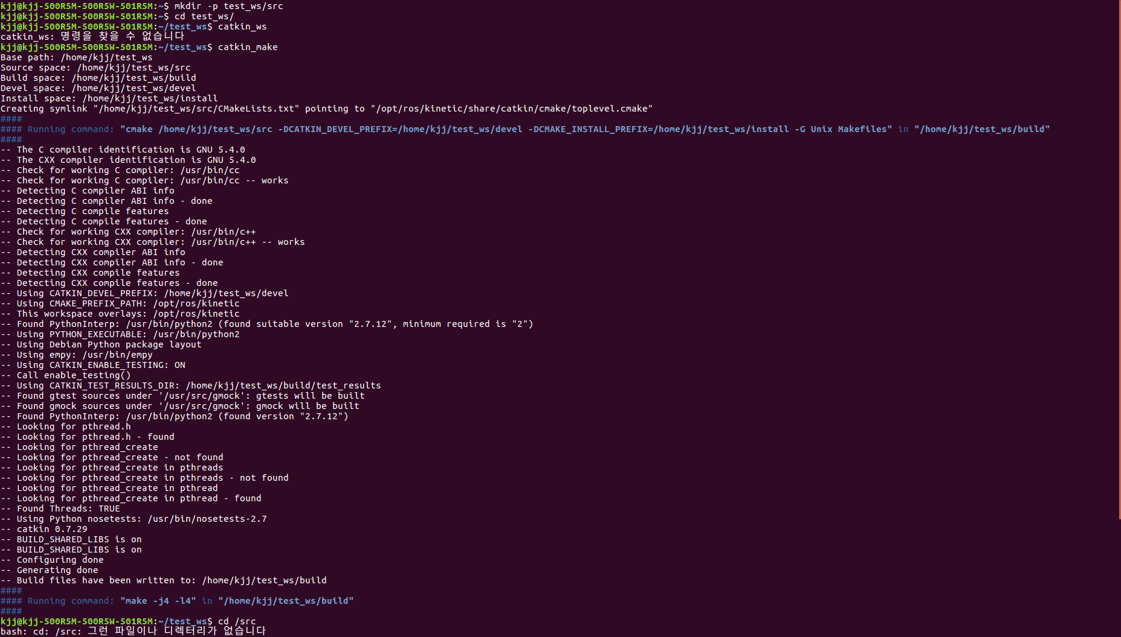
ROS PACKGE

Slide 3
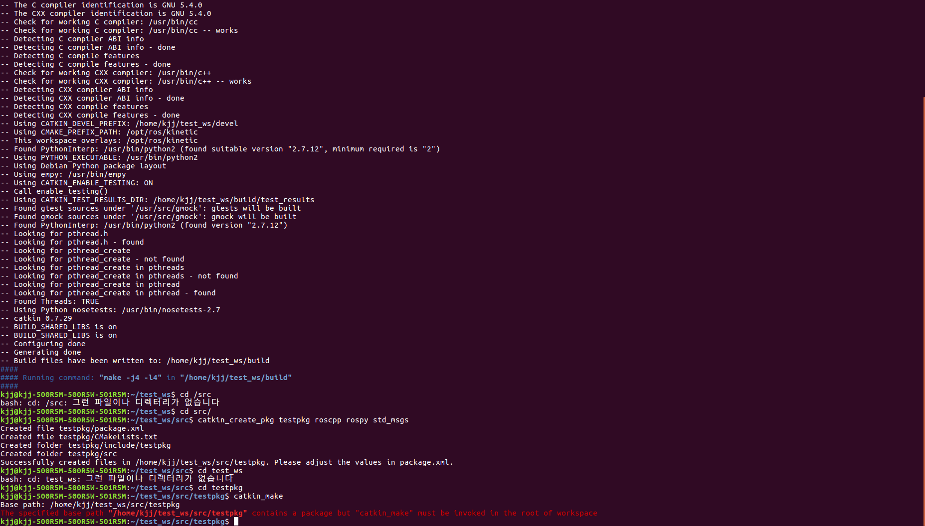
ROS PACKGE

Slide 4
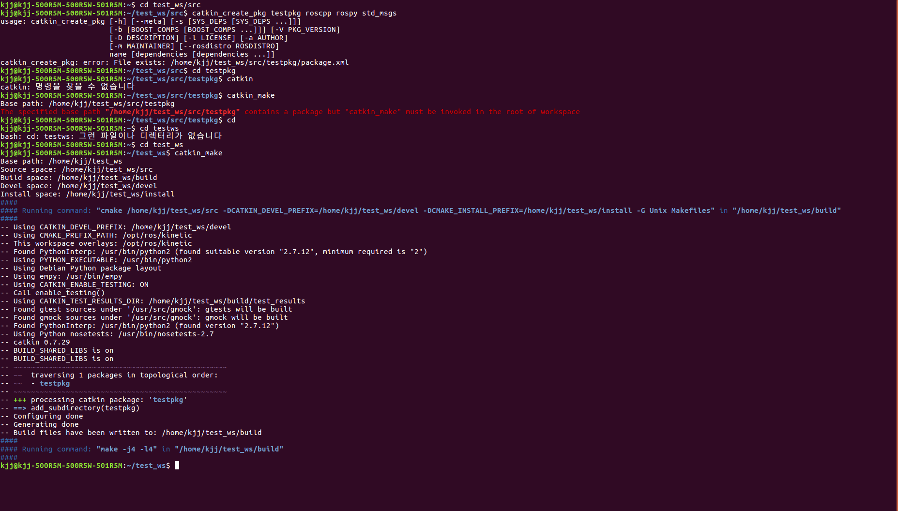
ROS PACKGE

Slide 5
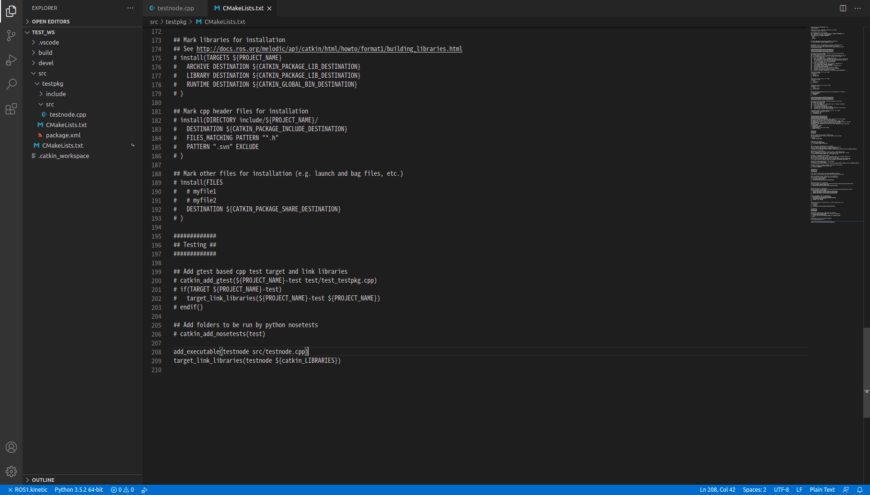
ROS NODE

Slide 6
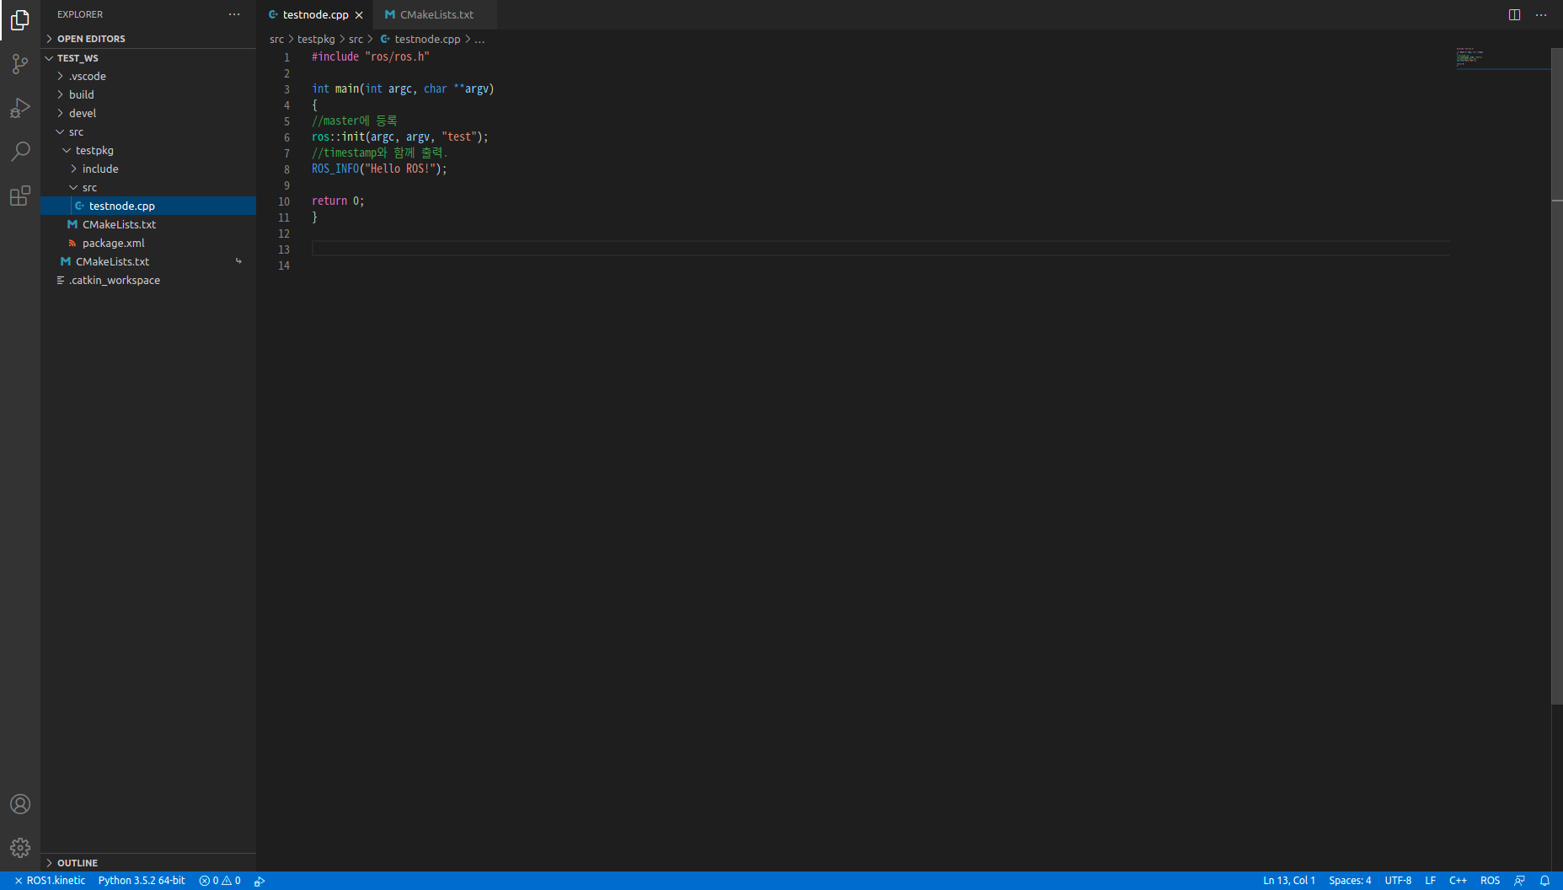
ROS NODE

Slide 7

ROS NODE

Slide 8
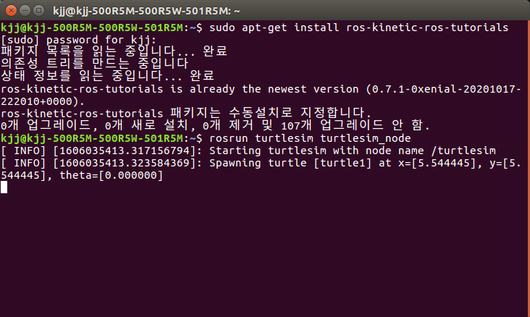
ROS TOPIC

Slide 9
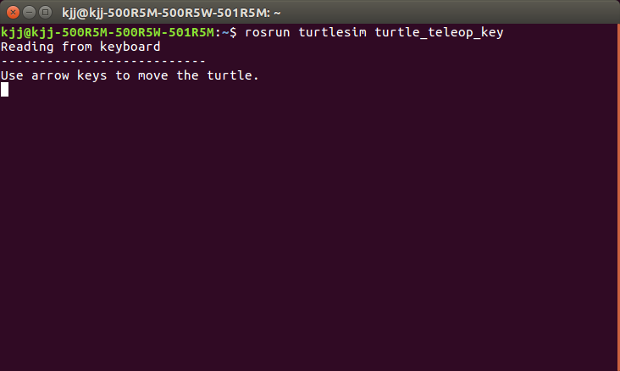
ROS TOPIC

Slide 10
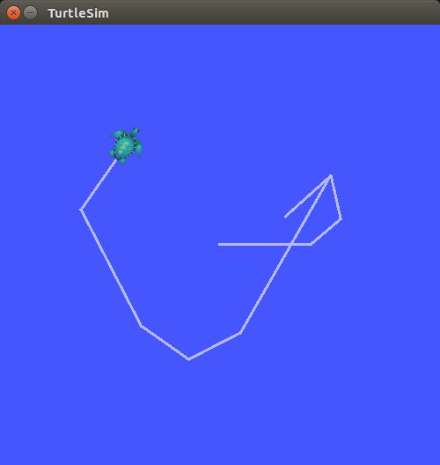
ROS TOPIC

Slide 11

ROS TOPIC

Slide 12
ROS TOPIC

Slide 13
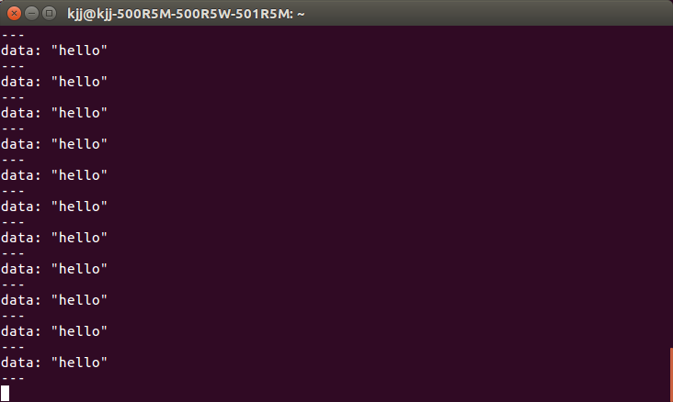
ROS TOPIC

Slide 14

ROS TOPIC

Slide 15

ROS TOPIC

Slide 16

ROS TOPIC

Slide 17
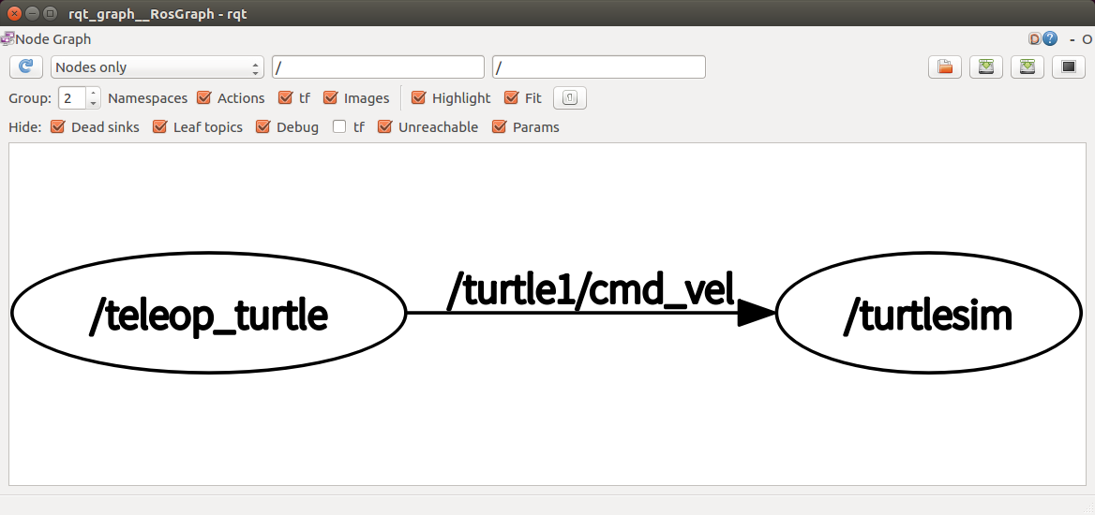
ROS TOPIC

Slide 18
ROS TOPIC

Slide 19
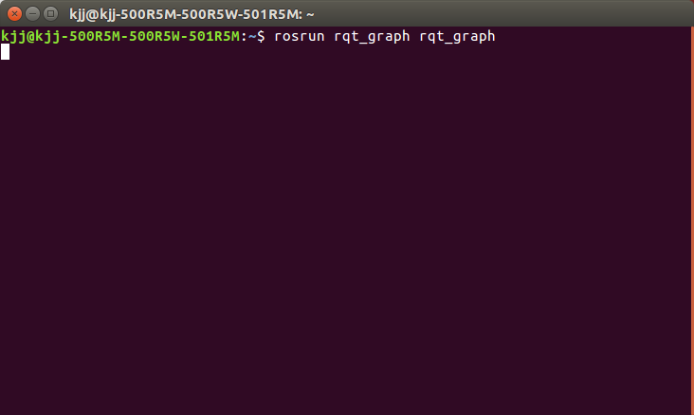
ROS TOPIC

Slide 20
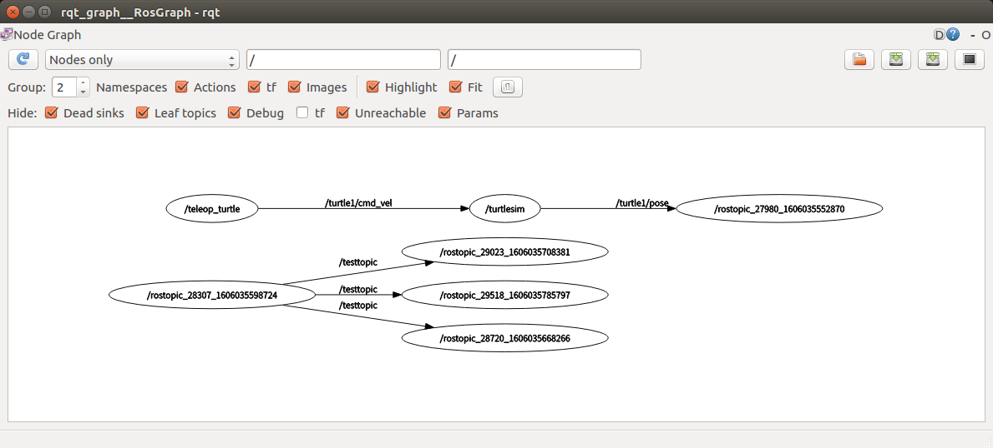
ROS TOPIC

Slide 21
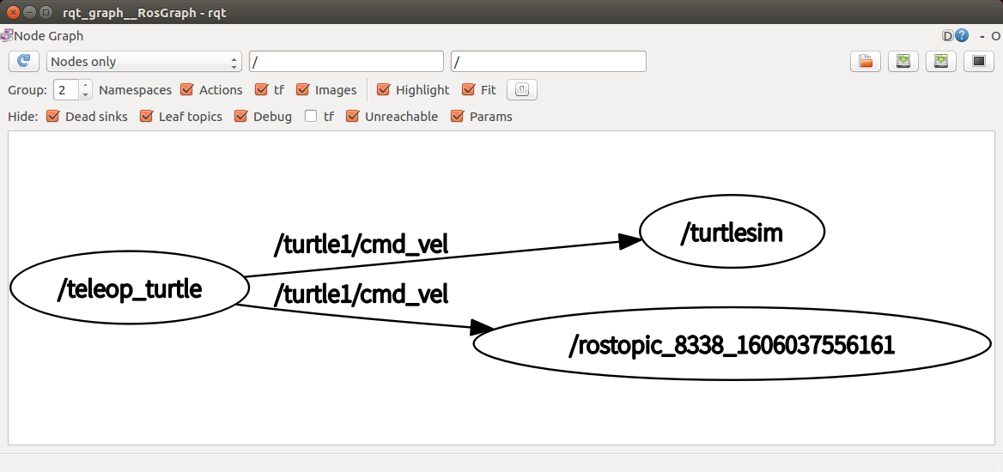
ROS TOPIC

Slide 22
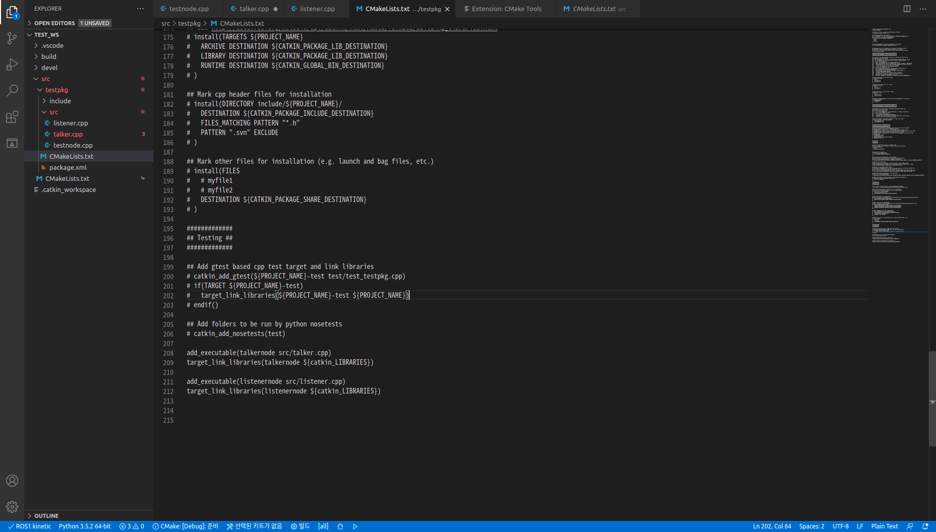
ROS NODE

Slide 23

ROS TOPIC

Slide 24

ROS TOPIC

Slide 25
ROS TOPIC

